Slide 1
2021-22
Performance to December 2021

Slide 2
Areas to
cover
Section 1
Key messages and financial highlights
Section 2
Financial performance – actual compared to budget
Section 3
Income arrears
Section 4
Voids rent loss and void relets
Section 5
Development performance

Slide 3
Key messages and highlights
There have been no changes to the Board during 2021/22.
G1/V1 grading reaffirmed in October 2021.
A+ (stable outlook) Standard & Poor’s reaffirmed in October 2021
Successfully completed a new £70m bond in January 2022
All financial covenants have been comfortably achieved, each maintaining significant headroom.
Substantial cash reserves and undrawn facilities
The new customer relationship management project is progressing as planned and this will provide a much more streamlined service to customers. The first phase is due to go live in May 2022.
The initial findings from the Savills SHAPE modelling has been received which has identified the cost of compliance with net zero carbon, based on current technologies that are available. The bulk of these costs have been incorporated into our business plan.
Financial highlights for the period: April to December 2021 (unaudited)
Turnover for the period was £46.7m (2020: £45.0m)
Social housing contributed to 81% of total turnover (2020: 77%)*
Operating surplus for the period was £13.8m (2020: £14.8m)*
Operating margin on social housing lettings was 33% (2020: 39%)*
Overall operating margin was 30% (2020: 31%)*
Overall operating margin (excluding asset sales) was 31% (2020: 34%)*
The overall surplus for the period was £7.1m (2020: £7.6m)*
Interest cover forecast for 2021/22 is 1.27 (covenant 1.10)
Gearing forecast for 2021/22 is 54% (covenant 80%)
* Operating results for the previous financial year were impacted by the covid-19 pandemic e.g. reduction in costs relating to repairs and planned works, an increase in void rent loss and timing of asset sales.

Slide 4
Financial Performance - April to December 2021
Financial Performance April 2021 to December 2021 - variance to budget
Operating profit of £13.8m is £1.7m favourable to budget, returning an operating margin of 30%.
This is a strong result and is due to a combination of factors as outlined below:
Income exceeded the budget overall by £1.7m; the main variances relate to:
Delays in the prior year and current year property handovers has resulted in reduced social housing rent.
Shared ownership sales volume is behind budget due to the re-phasing of scheme handovers, the average profit remains strong and is greater than budgeted assumptions due to increased market values.
Open market sales has benefitted from several sales being completed in this financial year, that were originally planned for last year.
Expenditure was in-line with budget and the main variances relate to:
Vacant staff post savings offset by increased void repairs (both volume & average costs).
Bad debt savings as actual YTD performance was 0.6% compared to a forecasted 2.6%. This forecast to be 1.5% by the year-end.
Shared ownership costs are lower and open market sale costs are higher, in line with the income variance.
Depreciation is lower due to delays in handovers and other capital expenditure.
Overall, total comprehensive income of £7.1m is £1.9m higher than budgeted.

Slide 5
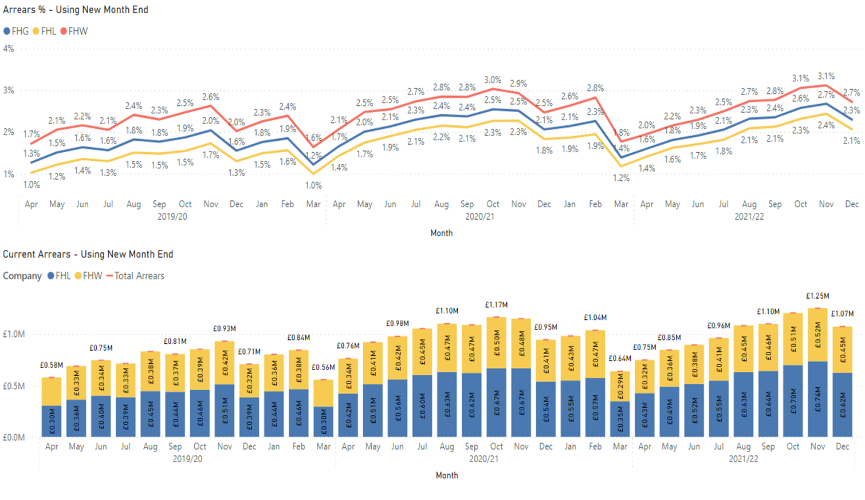
Arrears
Dec 2021 arrears position
Arrears for the Group are 0.2% higher than for the same period last year.
Arrears greater than £1k are 0.9% as they were in December 2020. Arrears under £350 is the same as the previous year at 0.4% of rent roll.
There is an increase in arrears for both customers claiming Universal Credit (1.4% of the rent roll compared to 1.3% in December 2020) and customers not in receipt of Universal Credit (0.9% of the rent roll compared to 0.8% in December 2020).
This indicates a general struggle in customers being able to afford their essential bills rather than a challenge for specific circumstances.
Data as at 3rd October 2021, Social & Affordable only

Slide 6
Social / affordable void rent loss & relets
Dec 2021 position
Void rent loss (VRL)
The quarter to Dec 2021 ended with an overall void rent loss for social and affordable homes of £154k (2020: £232k) and is in line with the 2018/19 performance.
Void relets
The average turnaround to Dec 2021 is 26 days and is a significant improvement when compared to the prior end of year performance of 42.7 days,

Slide 7
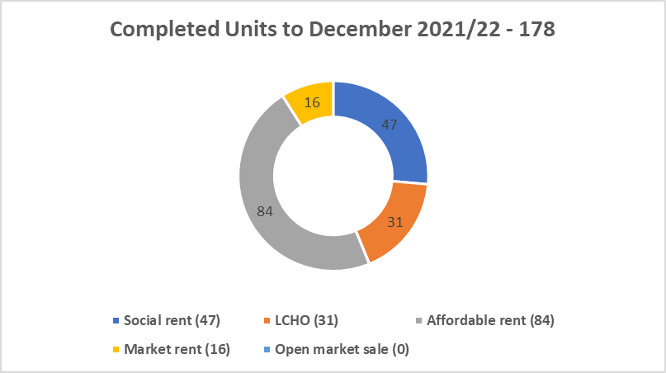
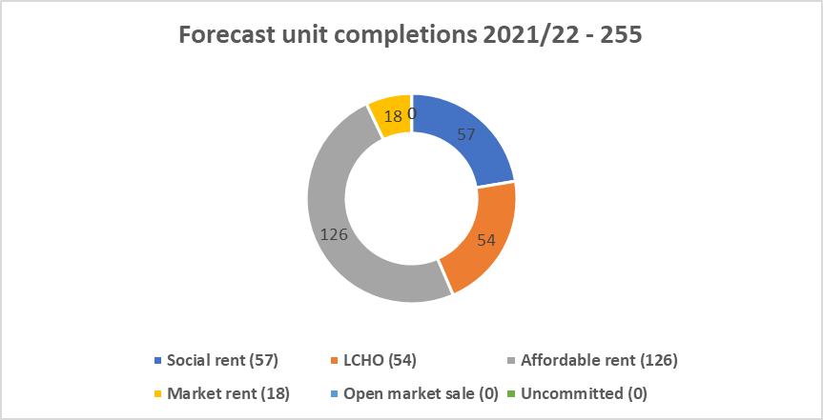
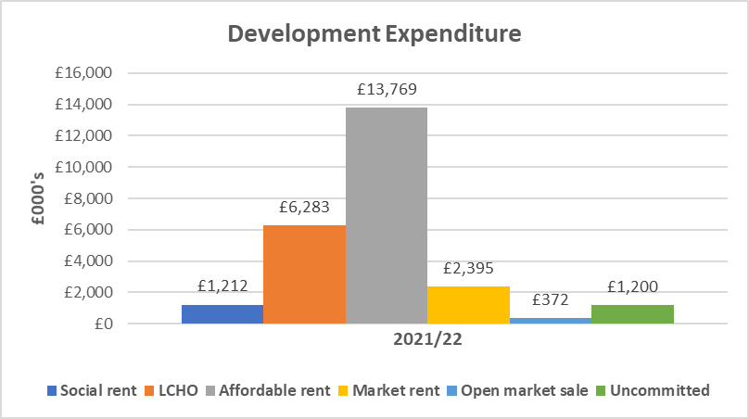
Development performance
Development forecast performance to March 2022
Total forecast spend in 2021/22 is £36.9m and is in line with budget; £1.2m of the total forecast spend relates to uncommitted costs and work is on-going to secure schemes. 178 homes have been delivered to December, and the forecast for the year is 255 homes (includes nil uncommitted homes), compared to the budget of 336 homes.
Sales activity to December has generated £6.6m, the income received is greater for open market sales due to slippage from 2020/21 and shared ownership income is lower due to the timing of sales, however the average profit per sale is benefitting from market value increases.
As at the 31st December 2021, 596 units are secured, and 146 units are in the pipeline. 24% of approved development expenditure is committed and 9% is awaiting approval.
Business plans are built with prudent assumptions to effectively manage risks associated with new development such as falling property values, rent values and sales risk.
Homes England has awarded £171m of grant under the Affordable Homes Programme to a joint bid between Futures, Midland Heart and emh. This provides the Group with an additional £21.8m in funding which go towards delivering 500 homes.
No reliance on sales income and/or grant income to meet financial covenants so business plans can operate effectively within their funding facilities.

