Slide 1
2021-22
Performance to September 2021

Slide 2
Areas to
cover
Section 1
Key messages and financial highlights
Section 2
Financial performance – actual compared to budget
Section 3
Income arrears
Section 4
Voids rent loss and void relets
Section 5
Development performance

Slide 3
Key messages and highlights
There have been no changes to the Board during 2021/22.
G1/V1 grading reaffirmed in October 2021.
A+ (stable outlook) Standard & Poor’s reaffirmed in October 2021
All financial covenants have been comfortably achieved, each maintaining significant headroom.
Substantial cash reserves and undrawn facilities
The new customer relationship management project is progressing as planned and this will provide a much more streamlined service to customers.
We are implementing Savills SHAPE modelling software by March 2022 and this will help us better estimate the cost of compliance with net zero carbon, based on current technologies that are available.
New developments are being affected by the global materials shortage, however the overall Corporate Plan target is still on track.
Financial highlights for the period, April to September 2021 (unaudited)
Turnover for the period was £26.5m (2020: £25.7m)
Social housing contributed to 82% of total turnover (2020: 77%)*
Operating surplus for the period was £10.5m (2020: £12.4m)*
Operating margin on social housing lettings was 35% (2020: 46%)*
Overall operating margin was 32% (2020: 37%)*
Overall operating margin (excluding asset sales) was 34% (2020: 42%)*
The overall surplus for the period was £5.7m (2020: £7.6m)*
Interest cover forecast for 2021/22 is 1.39 (covenant 1.10)
Gearing forecast for 2021/22 is 55% (covenant 80%)
* Operating results for the previous financial year were impacted by the covid-19 pandemic e.g. reduction in costs relating to repairs and planned works, an increase in void rent loss and timing of asset sales.

Slide 4
Financial Performance - April 2021 to Sept 2021
Financial Performance April 2021 to Sept 2021 - variance to budget
Operating profit of £10.5m is £1.1m favourable to budget, returning an operating margin of 33%.
This is a strong result and is due to a combination of factors as outlined below:
Income exceeded the budget overall; the main variances relate to:
Delays in the prior year property handovers has resulted in reduced social housing rent.
Shared ownership sales volume is behind budget and is forecast to catch-up throughout the coming months, the average profit remains strong and in-line with budgeted assumptions.
Open market sales has benefitted from several sales being realised that were originally planned into 2020/21.
Expenditure was marginally greater than budget, the main variances relate to:
Vacant staff posts, delays to major works as a result of material shortages and other operational costs still to be committed.
Bad debt savings with the quarterly performance at 1% compared to the budget of 2.6%
Shared ownership costs are lower and open market sale costs are higher, the variances are in line with the income variance.
Depreciation is lower due to delays in handovers and other capital expenditure.
Overall, total comprehensive income is £5.7m, £1.2m better than budgeted.

Slide 5
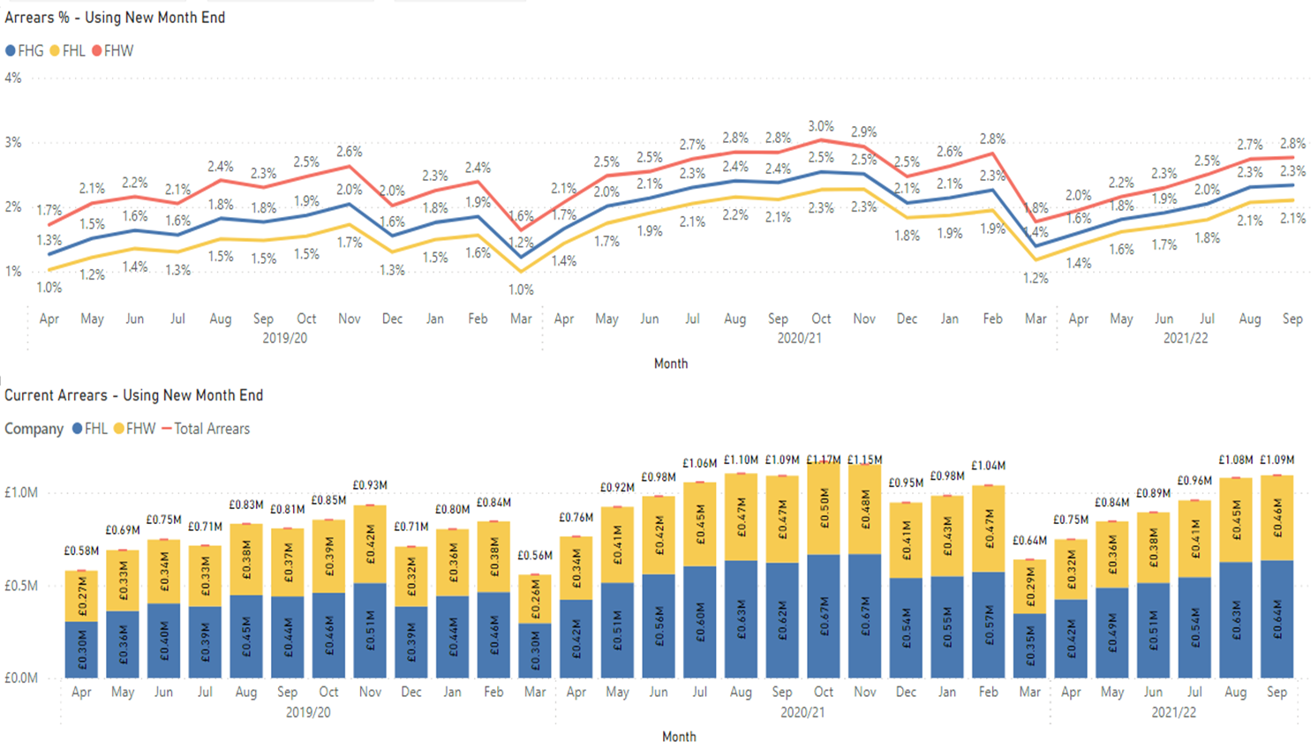
Arrears
Sept 2021 arrears position
Arrears for the Group are 0.1% lower than for the same period last year.
Arrears greater than £1k are 1% compared to the pre-covid 0.6% of rent roll..
The proportion of tenancies claiming Universal Credit has been increasing year-on-year, currently this is around 23%. The key driver of rent arrears remains housing benefit. Customers not in receipt of full housing benefit account for over 90% of rent arrears, irrespective of their Universal Credit status.
Data as at 3rd October 2021, Social & Affordable only

Slide 6
Social / affordable void rent loss & relets
Sept 2021 position
Void rent loss (VRL)
The quarter to Sept 2021 ended with an overall void rent loss for social and affordable homes of £111k (2020: £172k) and is at the lowest level since before 2016/17.
Void relets
The average turnaround to Sept 2021 is 26.1 days and is a significant improvement when compared to the prior end of year performance of 42.7 days,

Slide 7
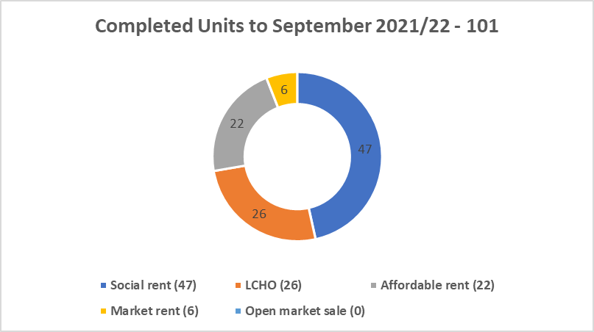
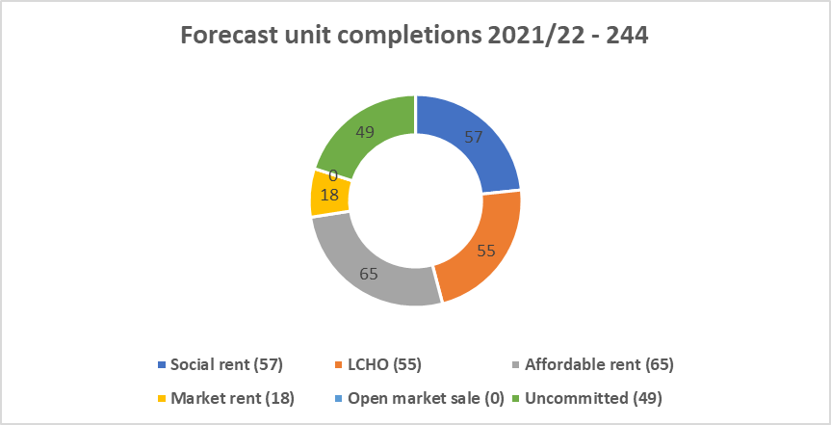
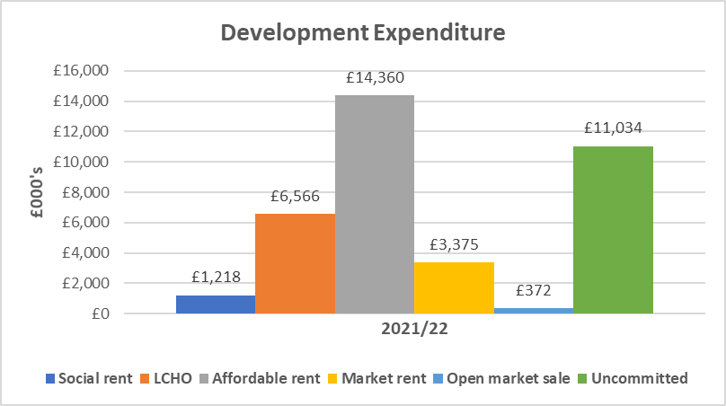
Development performance
Development forecast performance to March 2022
Total forecast spend in 2021/22 is £36.9m and is in line with budgeted; £11m of the total forecast spend relates to uncommitted costs and work is on-going to find and secure schemes. 101 homes have been delivered to September, and the forecast for the year is 244 homes (includes 49 uncommitted homes), compared to the budget of 336 homes.
Sales activity to September has generated £4.5m, the income received is greater for open market sales due to slippage from 2020/21 and shared ownership income is lower due to the timing of sales, the average profit per sale was in-line with the budgeted position.
To deliver the corporate plan and growth aspirations, an ambitious 7-year development programme was approved by the Board in March 2021 to deliver 1,583 homes by 2028.
As at the 30th September 2021, 606 units are secured, and 149 units are in the pipeline. 24% of approved development expenditure is committed and 9% is awaiting approval.
Business plans are built with prudent assumptions to effectively manage risks associated with new development such as falling property values, rent values and sales risk.
Homes England bid has confirmed the strategic partner bid to deliver 500 homes under the 2021-2026 Affordable Homes Programme.
No reliance on sales income and/or grant income to meet financial covenants so business plans can operate effectively within their funding facilities.

